Slide 1
Power Apps Training

Slide 2
Assignments
Power Platform Training Assignments
https://degreed.com/plan/1892236
CG Portal:

Slide 3
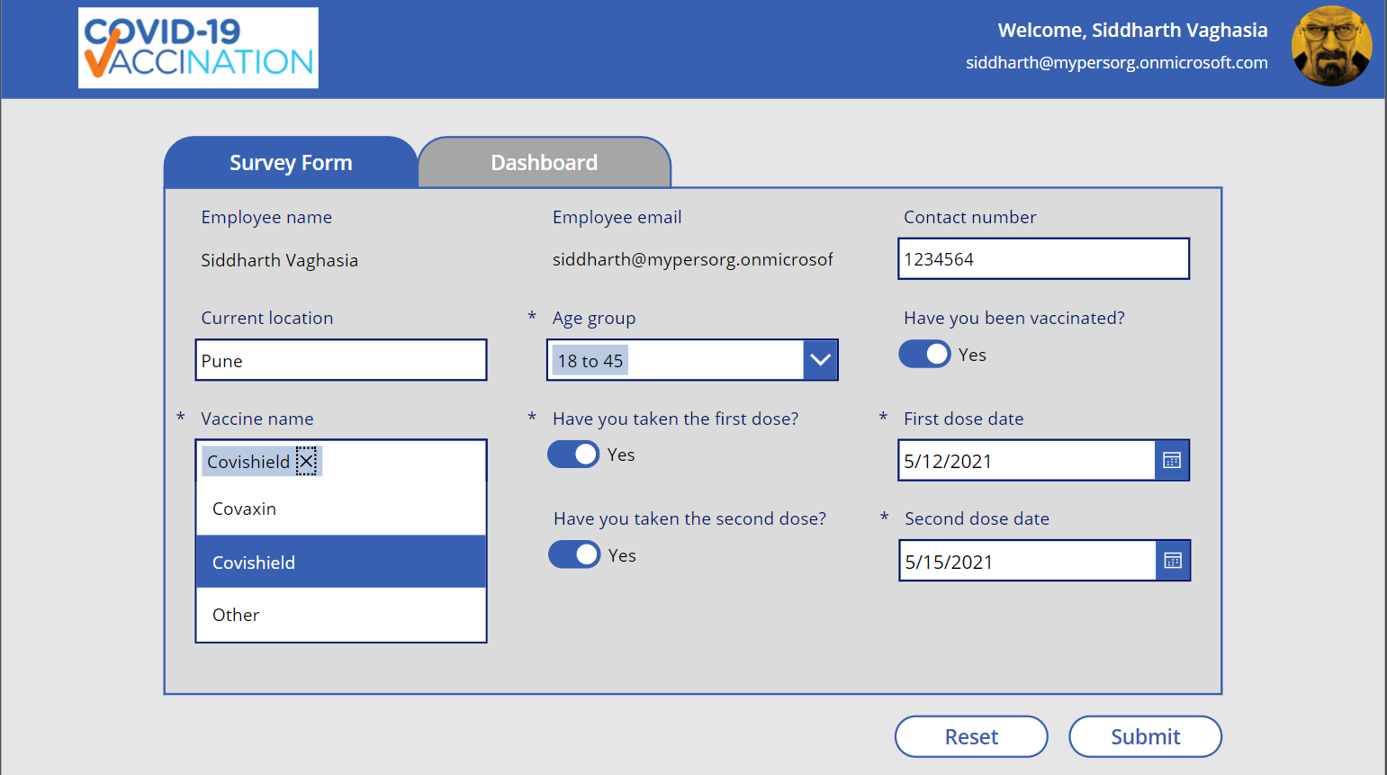
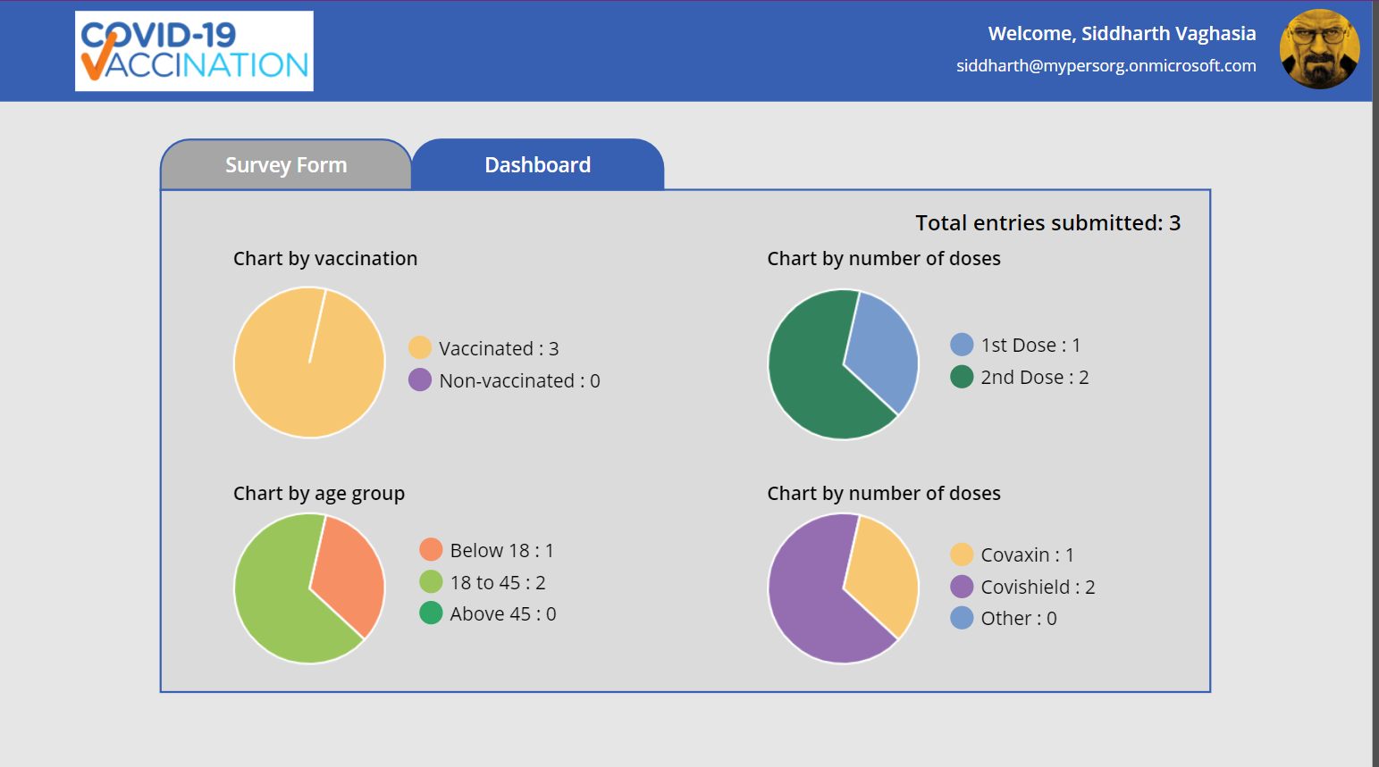
Covid Vaccination Survey App
Summary: PowerApps and Data verse based solution for companies to collect surveys (data) on the vaccination status of their employees.
Challenge
As with current situation on Covid, it is important to get ourselves vaccinated. All the countries governments are running vaccination drive.
It became important for companies to conduct a survey among employees about their vaccination status.
One to One survey is very complex way to record the vaccination data for every employee.
So, to accomplish the online process of Survey templates can be implemented on Power Platform.
Solution
This PowerApps and Data verse based application can be used to get the vaccination status of all the employees in organization.
Using the app, employee of the organization can provide information about their current vaccination status like if they have been vaccinated, have they taken both doses and which vaccine drive.
This survey data will give organization to how many employees have been vaccinated and other information related to vaccination.
Employee (normal user) can come to this app and update the data anytime until they fill out their information till dose 2.
HR/Admins(configurable) can view dashboard to see different charts based on total survey filled by employees, total vaccinated, employees taken first dose or second and which vaccine brand.
Power Automate to send the Email Notification to respective supervisor about the survey submission.
Data Source
Data verse
3

Slide 4
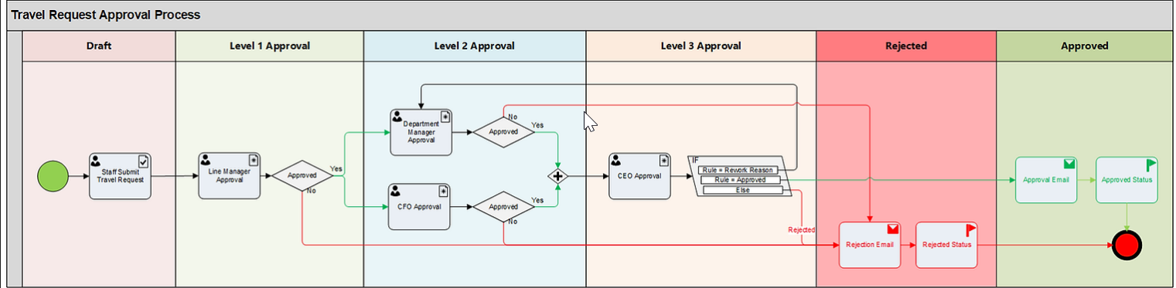
Travel Request Approval App
Summary:Power App Solution to build Travel Request Approval App that also includes Power Automate for different level of Travel Request Approval
Challenge
Travel for work is something most companies require. But before going on a business trip, the employee has to receive approval for travel.
However, the form should include important information such as employee data, the purpose of traveling, estimated expenses, and the supervisor’s approval.
Solution
A Staff member fills a Travel Request form with these fields: Purpose, Travel Start Date, Travel End Date and Travel Cost.
The Request is submitted for Level 1 Approval to the Line Manager who can either Approve or Reject the Travel Dates and Purpose. No need to provide a reason.
If Line Manager Approves, the Request is sent to the Department Manager and CFO simultaneously for Level 2 Approval.
Department Manager can Approve or Reject the request and has to provide the Reason behind the decision.
CFO can either Approve or Reject the Travel Cost. There is no need to provide a reason.
In Level 3 Approval, CEO receives the Travel Request when both Department Manager and CFO have Approved their part.
CEO can Approve or Reject or can ask Department Manager to rephrase the Approval Reason to make it more convincing (Rework).
If Rework is asked for, request goes back to Department Manager who can then change the Approval Reason to submit it back to CEO for reconsideration.
If either Line Manager, Department Manager, CFO or CEO Rejects the request, then inform Staff via email that it was Rejected and set Request Status to Rejected for future reference.
Data Source
Data verse
4

Slide 5
Expense Management System
Summary:A PowerApps and Dataverse based solution for companies to manage expense related data and approval associated (data) for their employees, along with the dashboard for admin to monitor the monthly expenses
Challenge
Manual entry and routing of expense reports
Lack of visibility into spend data
Lost Paper Based expense reports
Lengthy expense approval system and reimbursement cycles
Solution
Provision to add new Asset and save records in SharePoint list
Provision to upload Asset receipts
Provision to add multiple line items for a specific Asset
Provision to view details like my allocated Asset (Pending/ Approved/ Rejected).
Approval screen for approvers to approve the Asset Allocation
Approval flow based on amount of cost of Asset
If expense > 100000, then L1 and L2 approval
If expense <100000, then L1 approval
Export functionality should be there for admin users to data for total expenses in month
Data Source
Data verse
5

Slide 6
Leave Management System
Summary: A PowerApps and SharePoint based solution for companies to manage leave related data and approval associated (data) for their employees.
Challenge
Manual entry and routing of Leave Approval Process
Lack of visibility into Leave Data
Solution
Provision to create a leave request, data should be saved in back end
Selected approver while creating the leave request should receive the approval request for approve/reject
View screen should be there to show the details for applied leaves along with their status (Pending/Approved/Rejected)
After leave has been applied, Cancellation option should be there
Export functionality should be there to export leaves data
In case of some error occurs in the application, there should be some provision to notify the user (by displaying notification popup/via some email)
Data Source
SharePoint
6

